Slide 1
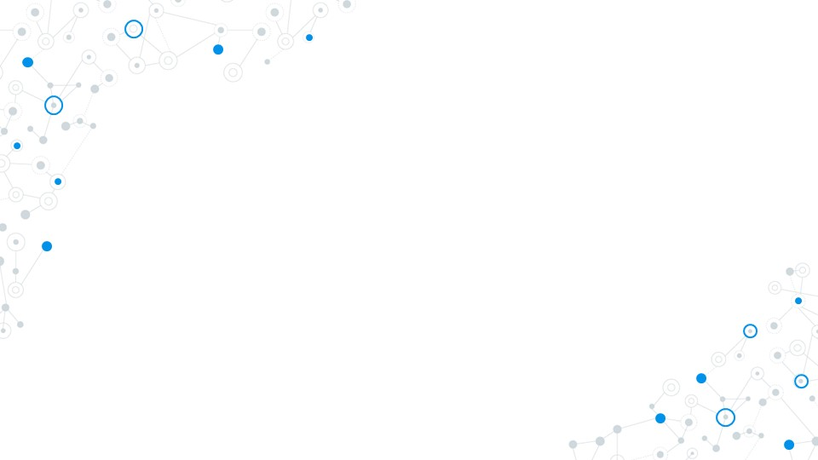

Project Work-Phase 2 Review/18EC7ICPR1
Project Review Presentation (50 Mks) – CIE 2
10 JUNE 2022
Dayananda Sagar College of Engineering, Bangalore, Karnataka
Department of Electronics & Communication Engineering
TECH -A- SIP
USN : 1DS18EC119 (Sec-C) Name : Hardik Anirudh
USN : 1DS18EC121 (Sec-C) Name : Isha Sharma
USN : 1DS18EC125 (Sec-C) Name : Laksh Bhagwani
USN : 1DS18EC129 (Sec-C) Name : Mohit Kumar
Project Batch No. : R-40
7th Semester
Name of the Project Guide:
Dr. Abhishek M B

Slide 2
Overview of the project phase-2 (CIE-2) presentation
Introduction
Literature Survey
Problem Statement
Scope of project
Objectives
Work done in phase 1 and phase 2 cie1
Implementation procedures carried out
Methodology adopted with Block-Diagrams & Flow-Charts
H/w & S/w tools used
Pin Diagram
Hardware-cloud-application integration
Recommendation System
Working video with Result
Photographs of the hardware developed
Advantages/Applications
Conclusion & Outcome of the project work
KSCST slide
Flow of the future works (jun’22 – July’22)
References

Slide 3
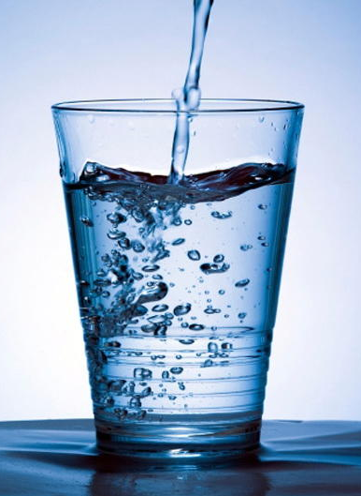
Introduction
Dizziness
Surveys show that the failure to consummate the adequate amount of water has proven to lead to numerous health problems.
Therefore, maintaining a proper level of hydration is very critical for the physiological functioning of a human.
Headache
UTIs
Constipation
Lethargic tendencies
Dull skin

Slide 4
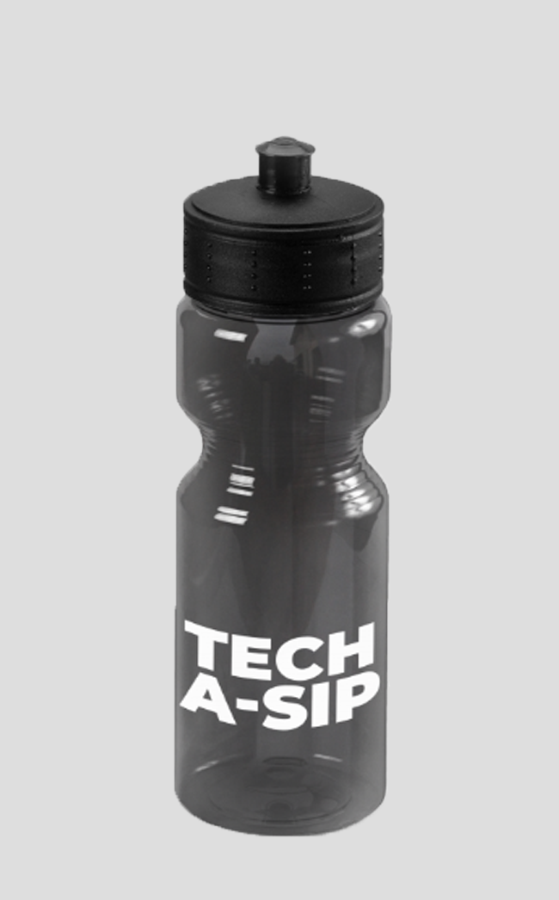
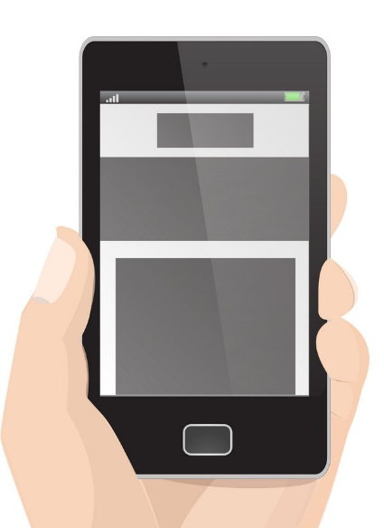
Introduction
This project conceptualizes the development of a system that detects and records the quantity and quality of water intake by the user and further uses the data to recommend the individual of the possible required hydration levels that he can attain.
The system is connected to the app and gives a reminder on the basis of the recommendation system designed for the particular user to drink water based on the analytics done on the data at the cloud. This system has the capability to induce a huge change of dynamics in the overall health of a person

Slide 5
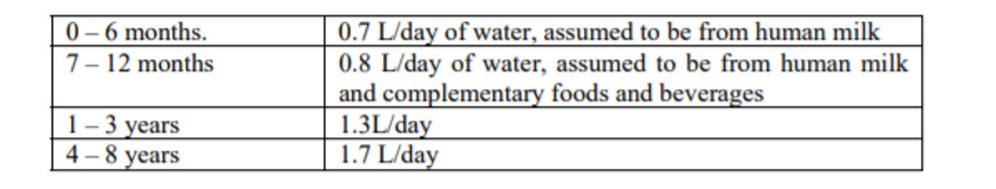
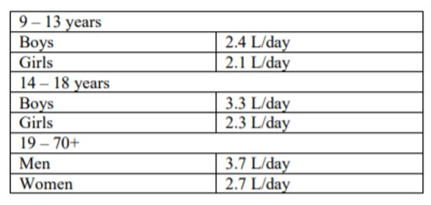
Introduction
The requirements and recommended water intake by individuals of different age groups by WHO.

Slide 6
Literature Survey
SL.NO. | Title of the paper | Source | Findings
1. | A. Grandjean (WHO): “Water Requirements, Impinging Factors, and Recommended Intakes” | WHO, Jan, 2009 | The paper talks about the requirements and recommended water intake by individuals of different age groups. The adverse consequences of inadequate intakes, and factors that affect fluid requirements is also highlighted.
2. | P.B. Pankajavalli, R. Saikumar, R.Maheswaran, "Hydration reminding samrt bottle: IoT experimentation". | IEEE, Jan 4, 2018 | A paper describes the experimentation architecture of Internet of Things in real life. One of the health issues is not drinking sufficient amount of water properly in a human's daily life. The IoT experiment facility described could provide a suitable platform for large scale experimentation and evaluation of IoT concept under real life conditions.
3. | Emil Jovanov, Vindhya R Nallathimmareddygari, Jonathan E. Pryor, “SmartStuff: A Case Study of a Smart Water Bottle” | IEEE Conference, Oct 18, 2016 | A case study of an intelligent water bottle that can precisely measure the amount of liquid in the bottle, monitor activity using inertial sensors, and physiological parameters using a touch and photoplethysmography sensor. This paper evaluate two system configurations : a smart water bottle integrated into a personal body sensor network and a cloud based device.

Slide 7
Literature Survey
SL.NO. | Title of the paper | Source | Findings
4. | Nam Eui Lee, Tae Hwa Lee, Dong Heui Seo, Sung Yeon Kim, “A Smart Water Bottle for New Seniors: Internet of Things (IoT) and Health Care Services | International Journal of Bio-Science and Bio-Technology, 2015 | Survey and in-depth interview data were collected, and a “persona” was used to understand new seniors’ goals and needs. The results showed that they struggled to adhere to habitual water consumption. Further, a smart water bottle that guides users to consistently drink appropriate amounts of water was addressed by applying the Internet of Things (IoT) technology to health care services.
5. | LaizhongCui· ShuYang· FeiChen · ZhongMing· NanLu· JingQin, “A survey on application of machine learning for Internet of Things | Springer, June 11,2018 | The paper has made an attempt to cover the major applications of machine learning for IoT and the relevant techniques, including traffic profiling, IoT device identification, security, edge computing infrastructure, network management based on SDN, and typical IoT applications.

Slide 8
Literature Survey
SL.NO. | Title of the paper | Source | Findings
6. | Yogendra Singh Parihar, “Internet of Things and Nodemcu: A review of use of Nodemcu ESP8266 in IoT products" | JETIR, June 6, 2019 | A study attempted to identify the potential for consuming water, existing problems, types of consumers, and water-intake behavior for new seniors. Survey and in-depth interview data were collected, and a "persona" was used to understand new seniors' goals and needs. A smart water bottle that guides users to consistently drink appropriate amounts of water was applied by applying the Internet of Things (IoT) technology to health care services.
7. | Bo Dong, Ryan Gallant and Subir Biswas , “A self monitoring water bottle for tracking liquid intake” | IEEE Conference, Feb 12, 2015 | This paper presents the key concepts, system architecture, implementation details, and performance of an accelerometer-equipped bottle for monitoring and tracking liquid intake. An elastic band, equipped with sensor & other electronics, which can be attached to a regular water bottle in order to track the bottle’s usage movements. A Bluetooth based wireless link out of the electronic band is used for sending the detected drinking events to a smartphone or to a notebook computer for higher level tracking and data management.

Slide 9
Literature Survey
SL.NO. | Title of the paper | Source | Findings
8. | Ben-Chioma, A.E, Jack, A.S, Philipokere, “A Comparative study on the measurement of pH of water, using pH meter and water testing kit (testube method) in port Harcourt" | INTERNATIONAL JOURNAL OF APPLIED CHEMISTRY, Aug, 2015 | This study attempted to determine the accurate way or method of determining pH of water. High pH water clogs pipes, change's reaction process etc. while low pH water also has deleterious effects. Using poor water quality in personal or healthcare can potentially be life threatening.
9. | Hanan,Anak Agung Ngurah Gunawan, Made Sumadiyas, "Water level detection system based on ultrasonic sensors HC-SR04 and ESP8266-12 Modules with telegram and buzzer communication media" | Instrumentation Mesure Métrologie, Aug 30,2019 | This paper highlights the design a water surface-level detection system by using ultrasonic sensors and the ESP8266-12E module. The tools are Ultrasonic sensors HC-SR04, module ESP8266-12E, and buzzer a water container with a varied water height, the detection data will be sent to the ESP8266-12E module, then the system will send the information an output to sound the alarm. The final result is a system capable of detecting water surface level based on the ultrasonic sensor HC-SR04 and the ESP8266-12E module through telegram and buzzer communication media

Slide 10
Literature Survey
SL.NO. | Title of the paper | Source | Findings
10. | Paola Pierleoni, Roberto Concetti, Alberto Belli, Lorenzo Palma, "Amazon, Google and Microsoft Solutions for IoT: Architectures and Performance Comaparsion". | IEEE Conference, Dec 23, 2019 | In this paper we map the Cloud-IoT Platforms services with this architecture analyzing the key points for each platform. In order to conduct a comparative analysis of performance, we focus on a service made available by all platforms building the reference scenarios and the metrics to be taken into account.
11. | Choopan Rattanapoka, Somphop Chanthakit, Apatsaraporn Chimchai,Amorntip Sookkeaw,"An MQTT-based IoT Cloud platform with flow design by node-red". | IEEE Conference, Feb 17, 2020 | This paper presents the design and development of an MQTTbased IoT cloud platform with flow design by Node-RED to help developers save time to set up the IoT platform by themselves. The platform provides three main services: (1) MQTT broker for data transmission (2) Node-RED for designing the flow of data processing and displaying data in graphical form via Dashboard and (3) InfluxDB and MongoDB databases for storing data.

Slide 11
Problem Statement & Definition
Design solution to solve the issue of inadequate hydration.
Perform research/survey to conclude that the hydration level of an average human is less than what is required and design the smart water bottle to solve the obstacle problem.
Ideate a method to improve the health of society by prioritizing the requirements of adequate water intake in their daily life.
To design, develop and integrate the project that can be used for daily usage as it is based on hydration and relates to lifelong learning.
Apply knowledge of hardware such as microcontroller and sensors and software tools like application development, Arduino ide and cloud integration.

Slide 12
Scope of the project work
The scope of the project is to check the quality and quantity of water intake by the user and let the user fulfil his hydration needs.
Communicate effectively on the complex activities with the society.
Ideate a method to improve the health of society by prioritizing the requirements of adequate water intake in their daily life.

Slide 13
Objectives of the project work
To develop an integrated embedded hardware system which analyses the quantity and quality of water for user consumption.
To facilitate a personalized recommendation system utilizing Machine Learning algorithm specific to user hydration needs.
To develop an application providing user interface and integrating with cloud the same for smoother data monitoring and storage.

Slide 14
Work done in Phase1 and part of Phase2
Literature survey and hardware implementation
Cloud with microcontroller and Application design
Hardware, Cloud and App integration
Conducted research, tested different sensors and development board to get required outcome and integrated all the hardware together.
Setting up server at cloud and integrating it with the microcontroller. Developing an application for user interface
Integrating the application with cloud to send user inputs and receive the UI and finally with hardware
MOVING FURTHER
01
02
03
04

Slide 15
Implementation procedure for 2nd phase (part2)
Recommendation System
06
Updating UI
Improving the recommendation system to check hourly consumption, compare with goals and recommend accordingly
Updating the application to provide even better and smoother user interface
04
05
Debugging and Bridging
Display
Researching on the appropriate display hardware and its testing to show the water consumption via hardware
Debugging the recommendation system code and bridging it with the bottle
02
Temperature sensor
03
Hardware Integration
Researching on the appropriate temperature sensor and its testing
Coding both the additional hardware according to the requirements, integrating with existing hardware and debugging the errors
01

Slide 16
Methodology adopted with block-diagram
BOTTLE
Recommendation System
Temperature
Sensor
POWER
Information
Updated
&
Transmitted
US Sensor
PH Sensor
MQTT protocol
AWS EC2
HTTP protocol
User
Interface
ESP8266
LED
Dynamic Database
POWER
OLED
DEVICE
CLOUD
MOBILE APPLICATION

Slide 17
Hardware & Software tools used
HARDWARE USED:
NodeMCU
Ultrasonic sensor
pH sensor
LED
Li-ion battery
Temperature Sensor
OLED Display
SOFTWARE USED:
Arduino IDE
AWS
Node-RED
SSH Client
Kodular

Slide 18
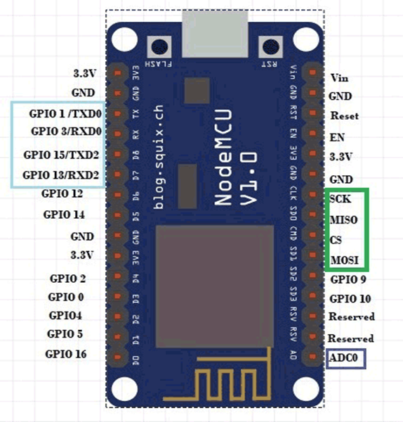
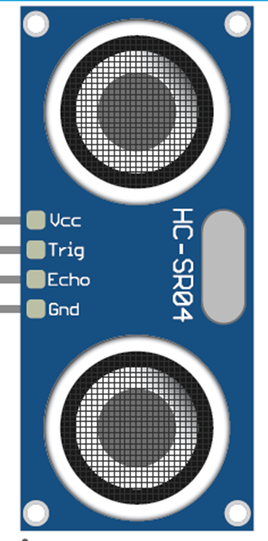
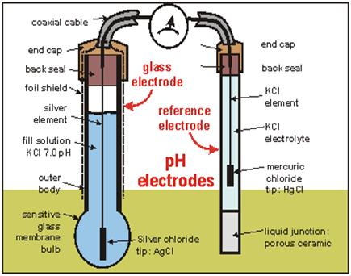
Working of Hardware

Slide 19
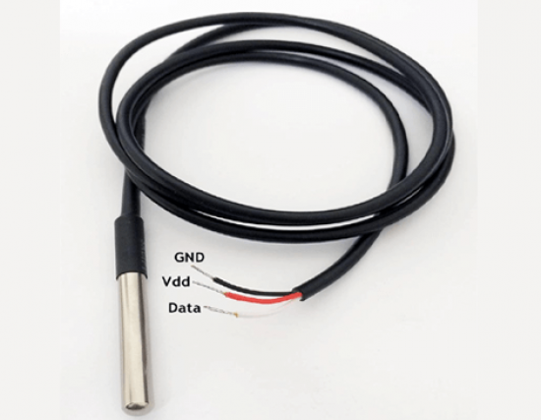
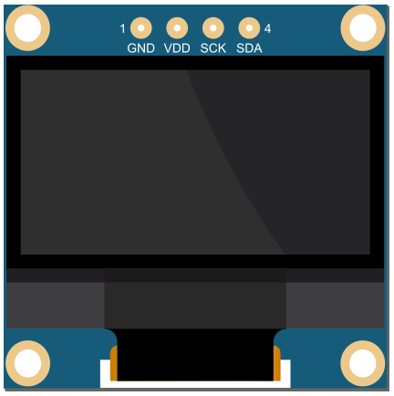
Working of Hardware
DS18B20 Temperature Sensor
OLED Display

Slide 20
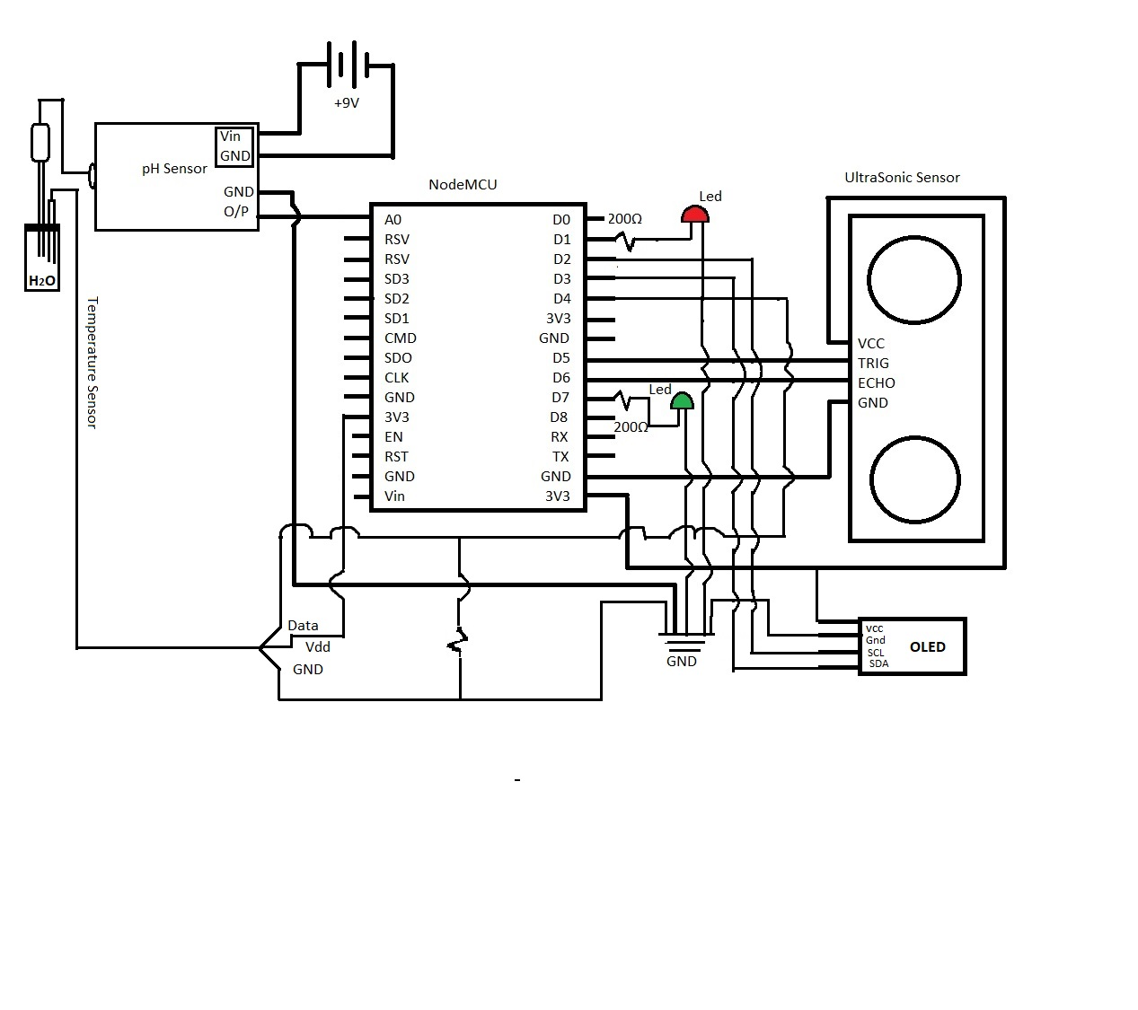
Pin Diagram

Slide 21
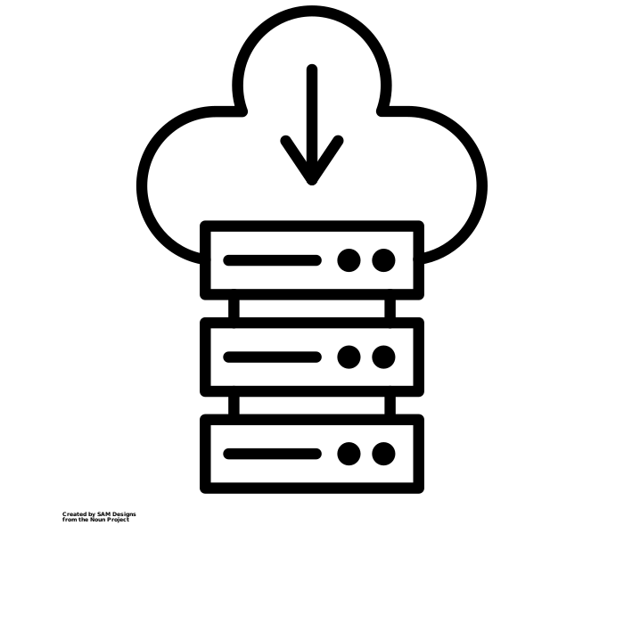
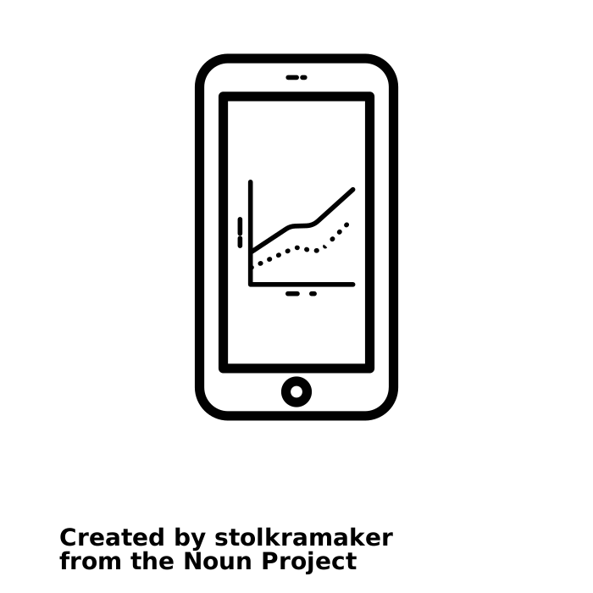
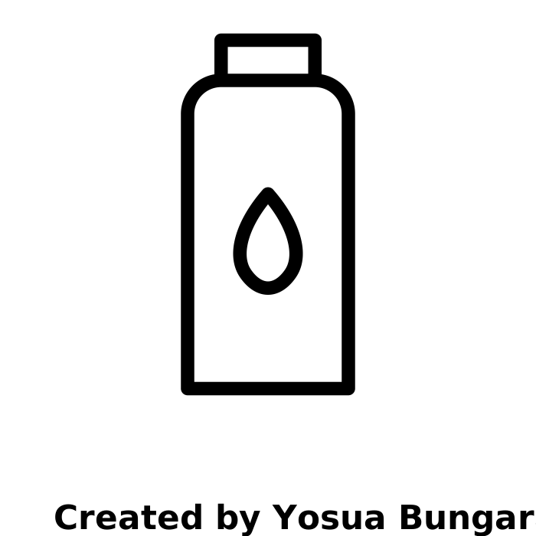
Hardware-Cloud-Application Integration
AWS CLOUD
BOTTLE
MOBILE APP

Slide 22
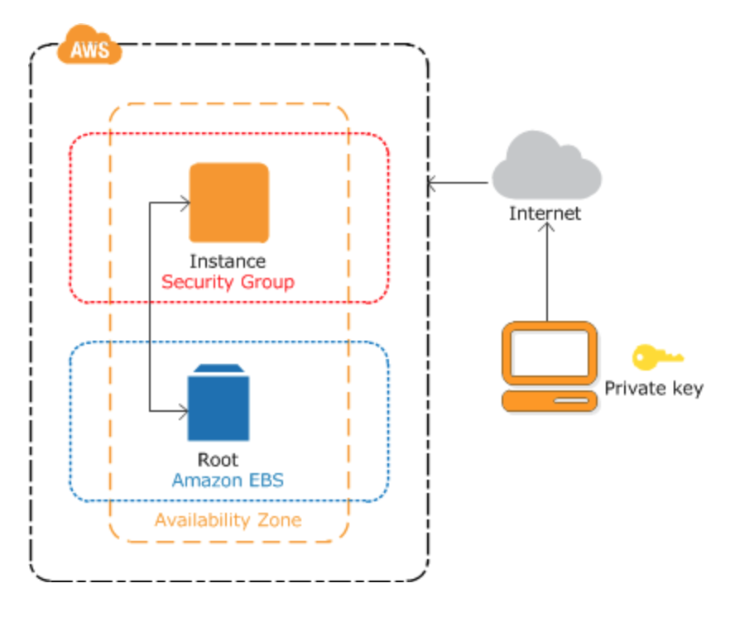
Hardware-Cloud Integration
Amazon Elastic Compute Cloud (Amazon EC2) provides scalable computing capacity in the Amazon Web Services (AWS) Cloud. Provision for virtual computing environments, called instances, to setup virtual servers as per need, configure security and networking, and manage storage.
AWS provides preconfigured templates for instances that package needs for a server. The server is fed data and can be configured to perform necessary analytics according to the requirements.
The microcontroller is connected to the instance using MQTT protocol and MQTT WSS protocol to publish and subscribe to messages.

Slide 23
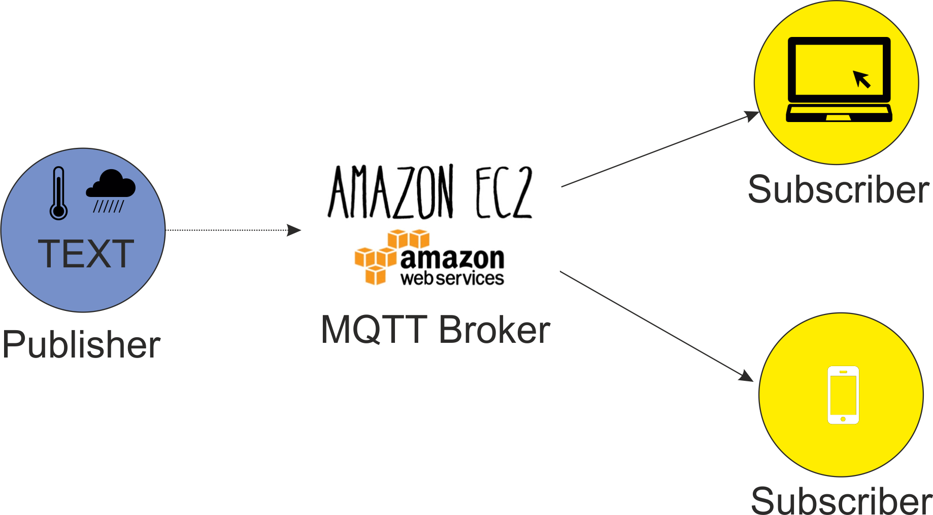
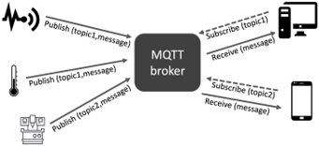
Hardware-Cloud Integration
The server is made to behave like a MQTT broker (Mosquitto) and the microcontroller like a MQTT client such as publishers and subscribers.
The microcontroller is made the publisher. Its responsibility is to publish the messages based on a topic which help identifying a message.
The microcontroller publishes the quality and quantity of water present in the bottle. The Broker receives these messages via the MQTT/MQTT WSS protocol where this data is used for analytics at the cloud.
The microcontroller also acts as a subscriber and subscribes to messages for functioning of LEDs.

Slide 24
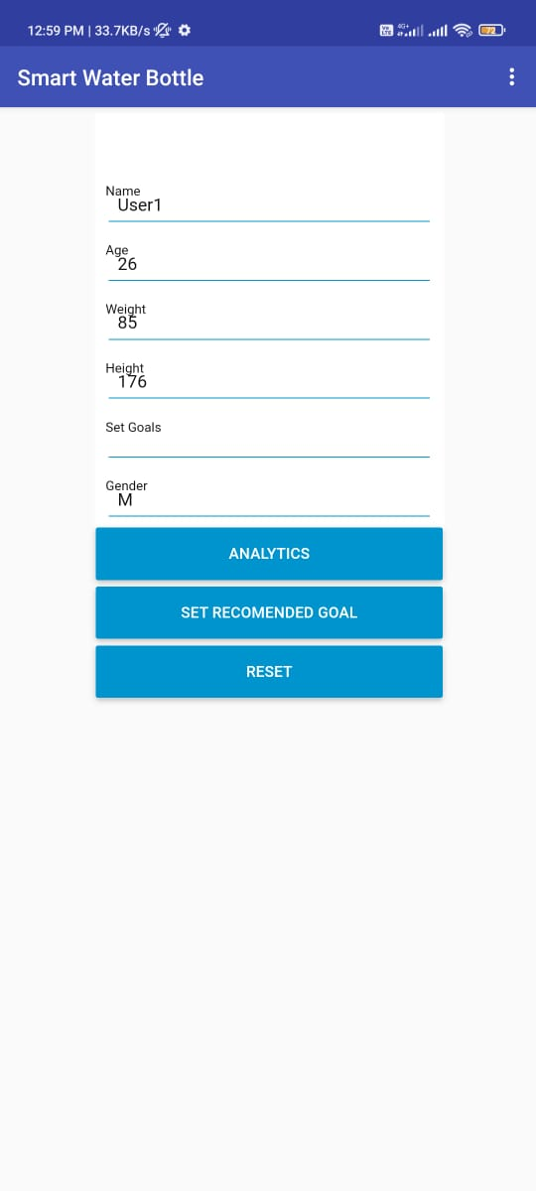
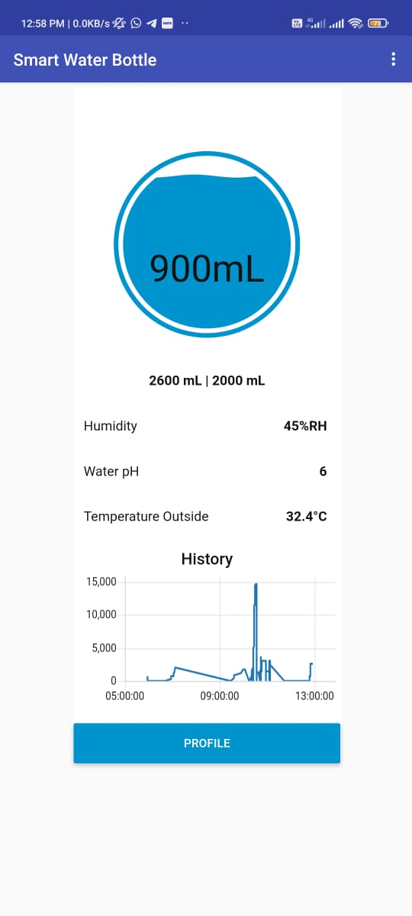
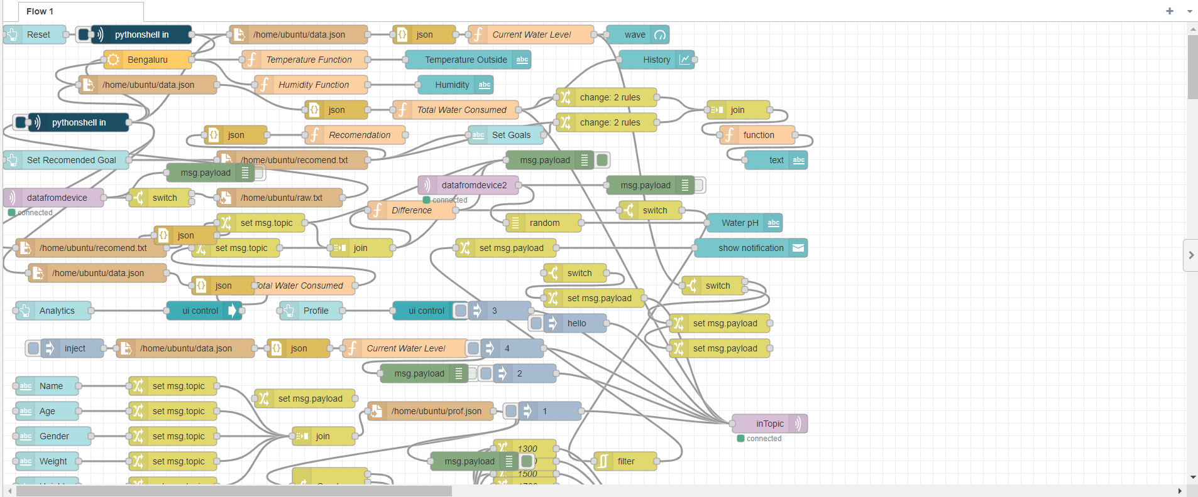
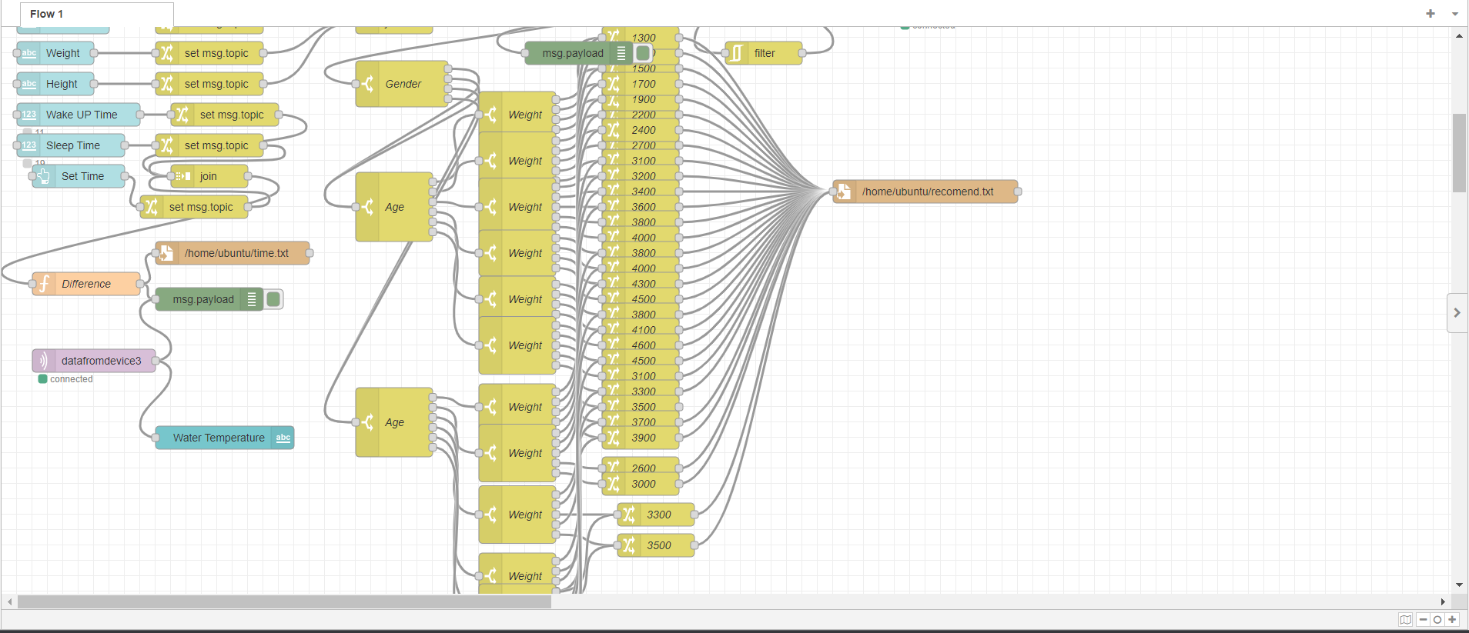
Cloud-Application Integration
Application Front end(Kodular)
Application Backend (Node-red)

Slide 25
Flow Chart for Recommendation system
Start
Input parameters
Gender
Age
Weight
Height
Wake Time
Sleep Time
Parameters through API
Temperature
Humidity
Taking input from user and API call
Setting recommended goal of user for the day (W)
Setting Hourly goal = W/T
Tracking user Consumption
Consumption of user per hour < hourly goal per hour
Remind user to drink water
True
False
Reset per hour goal for user
Reset Per hour goal for user
End
End

Slide 26
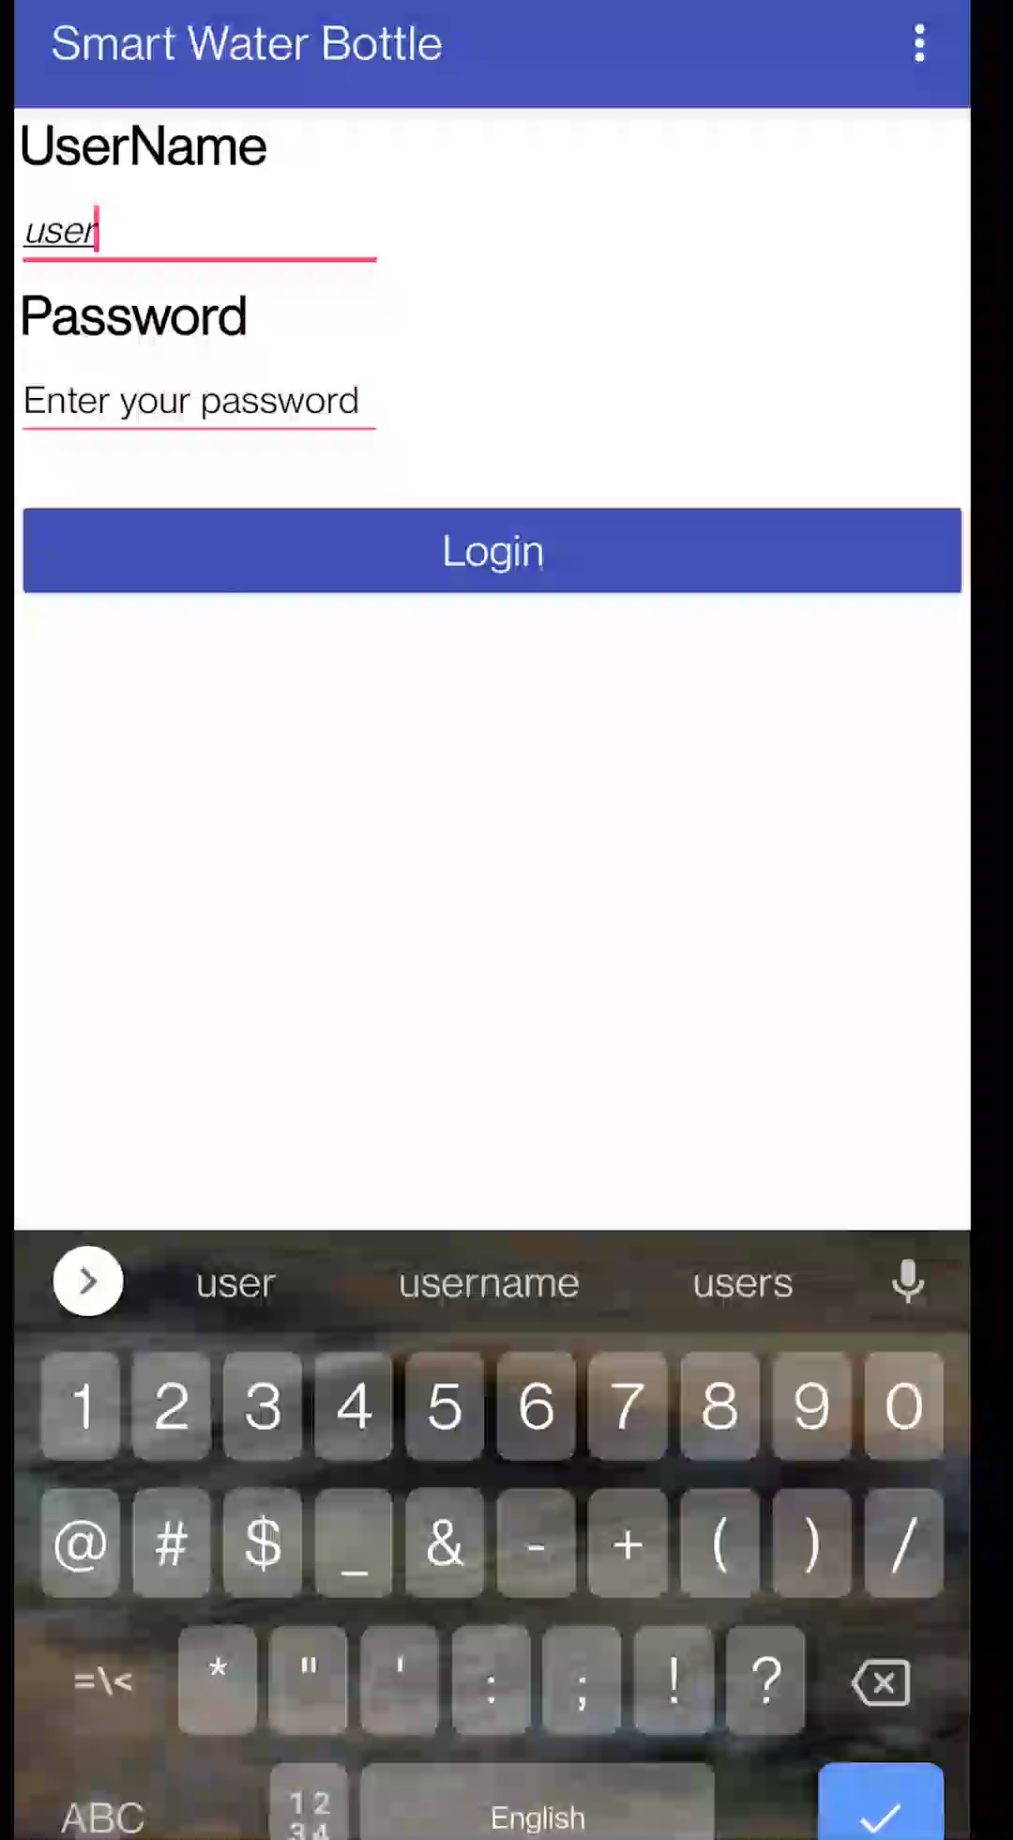
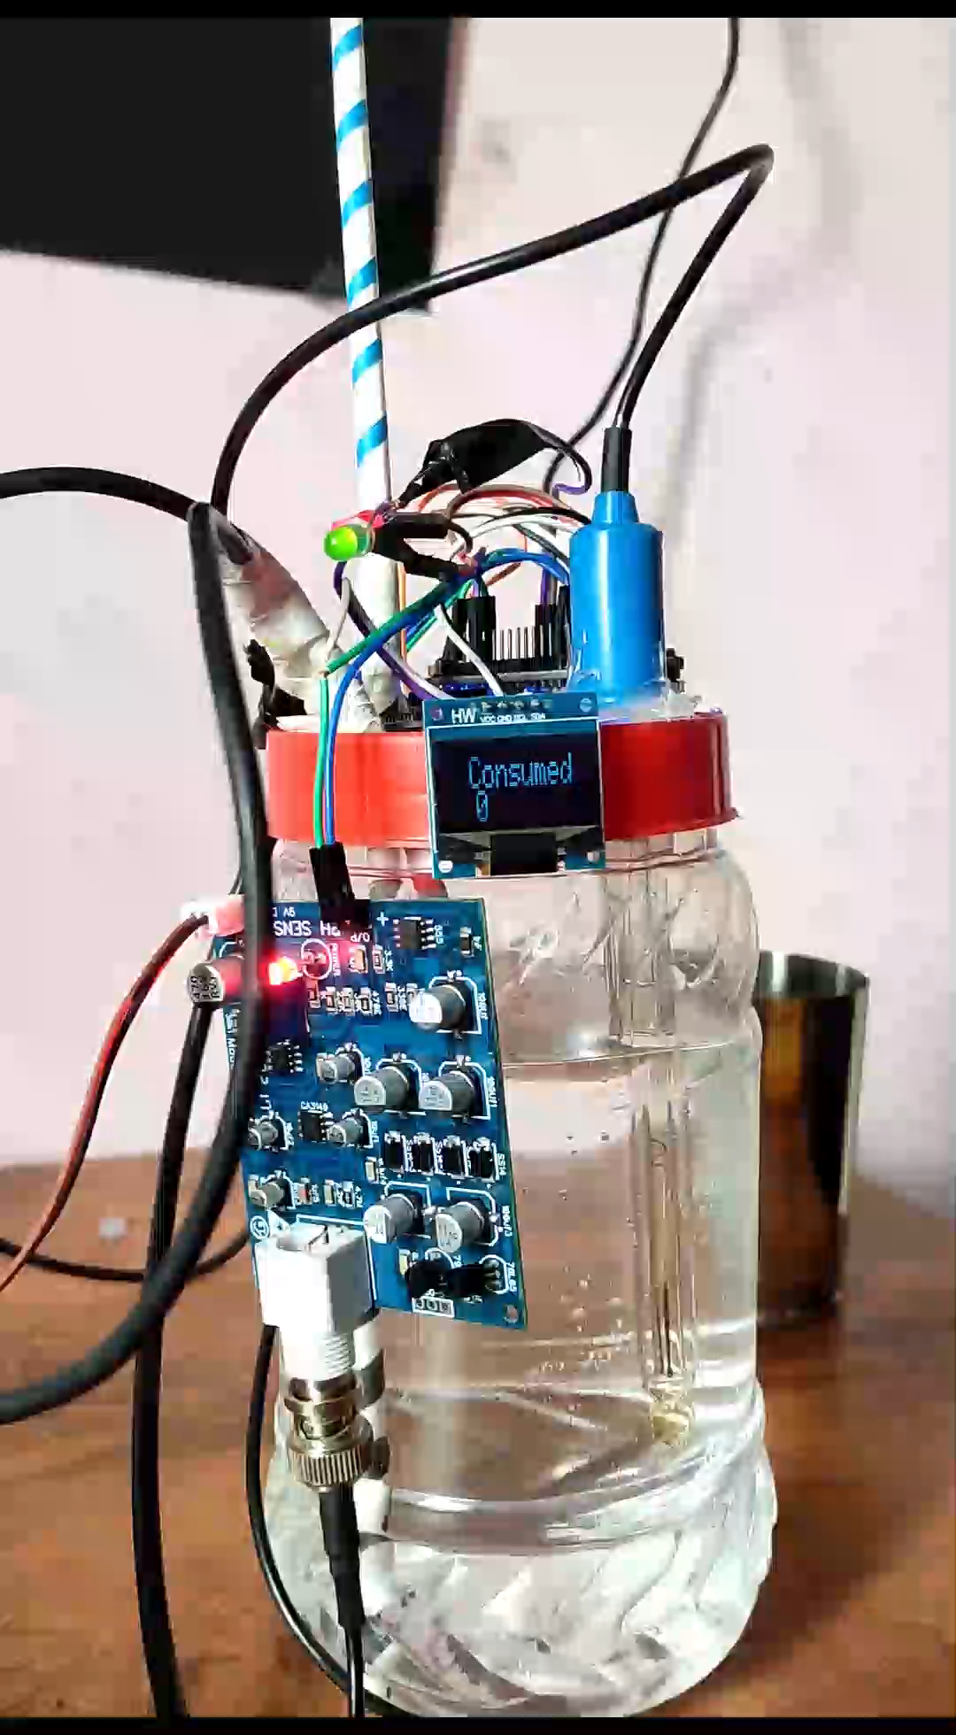
Second phase working video

Slide 27
Results
The temperature sensor and OLED display are tested, coded and debugged.
Recommendation system is updated and coded to provide hourly analytics.
The recommendation system is successfully able to compare hourly consumption and hydration goals to recommend appositely.
The Application is updated to provide a better and smoother user interface.
The App, recommendation system and the addition hardware are mounted, debugged and integrated together.
The results show that the system is able to take user inputs, information on quality and quantity of the user and perform analytics accordingly to recommend the user and help him achieve his hydration needs.

Slide 28
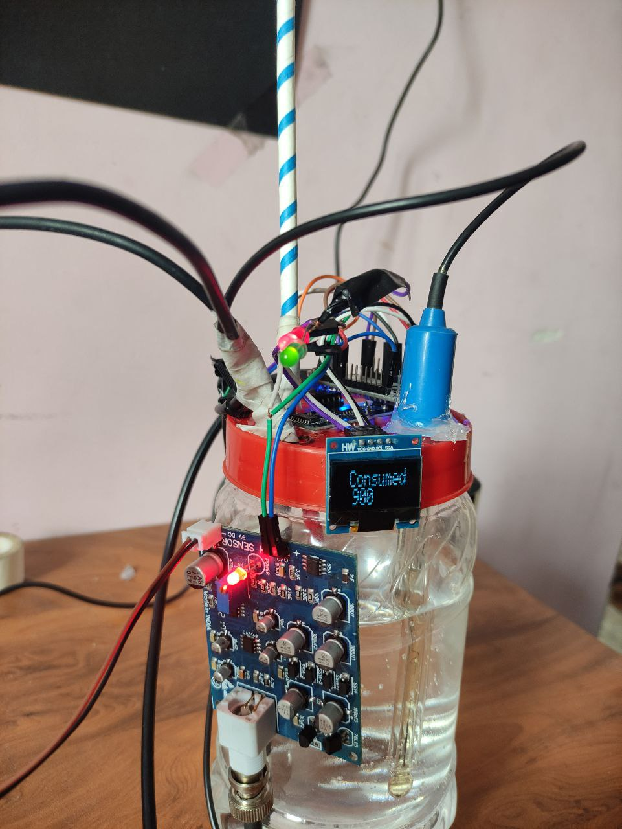
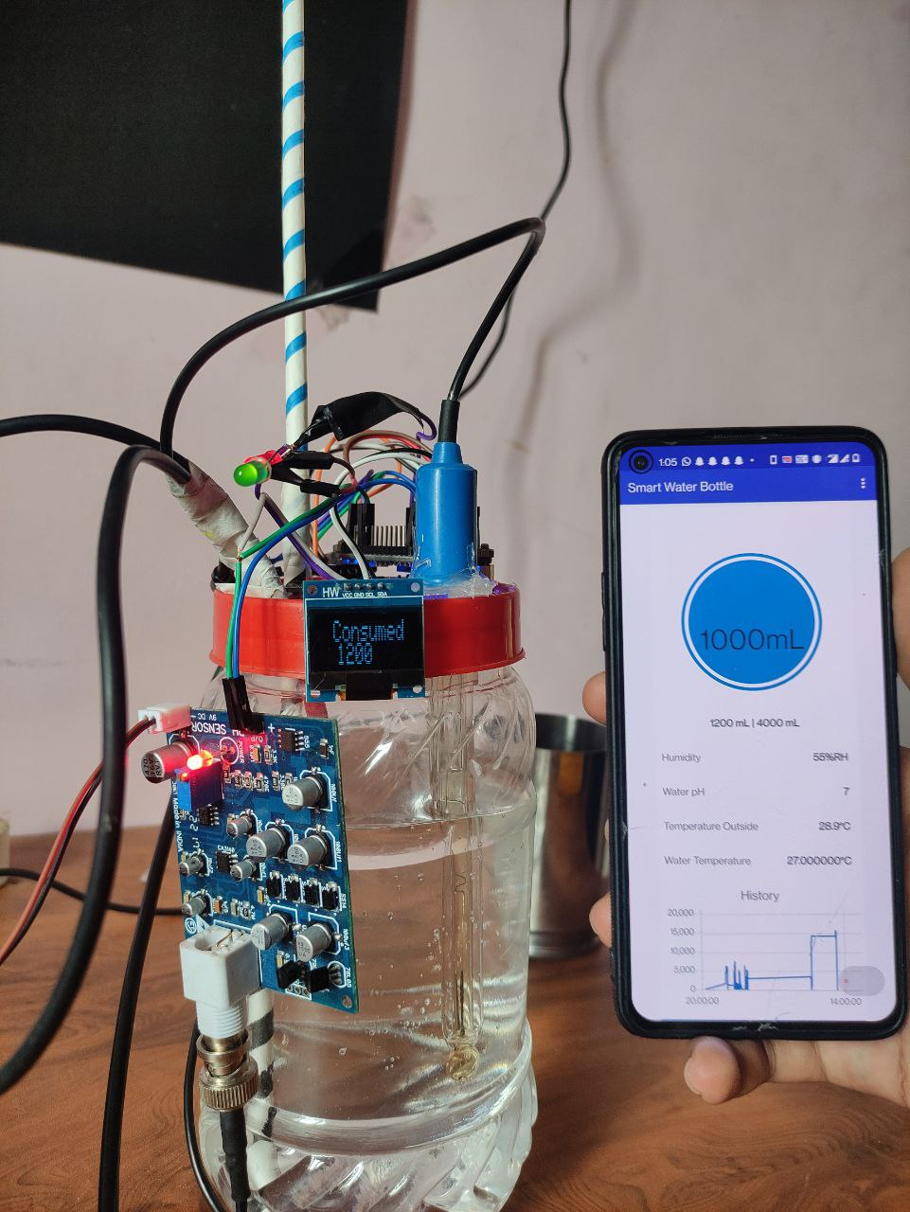
Photographs of the hardware prototype

Slide 29
Advantages / Applications
It could be used by everyone for regular use. This project can be especially helpful for fitness freaks and people who want to take their health seriously and focus on staying hydrated.
This product will be designed to notify, and recommend and remind him/her to drink good quality water, thereby helping the user stay fit.
It is very convenient and hence is quite user friendly.
It can help users ranging from a small child to a senior citizen.
It is accessible from anywhere at any time

Slide 30
Conclusions
The smart water bottle system based on the Internet of Things (IoT) which uses sensors, NodeMCU module, cloud integrator and app interface to keep a track of water intake of the user and using that data intimidate users to drink water.
The Received information like users input, quantity and quality of water and user’s consumption details have been used to structure the database and further used to recommends the user to drink adequate amount of water.
The application user interface as well as the OLED provide display for the consumption and other required parameters for the user to actively watch and act accordingly to fulfill his hydration requirements.

Slide 31
Outcome of the project work
A hardware prototype of the proposed system is designed and tested to see if it works as per the requirements.
The results obtained shows that the measurement of volume and quality of water in the bottle is accurate. They also show that analytics done using all the user data and water data is correct.
Recommendation of water consumption based on user inputs such as weight/height, quantity and quality of water and user’s desired water intake is provided via user interface.

Slide 32
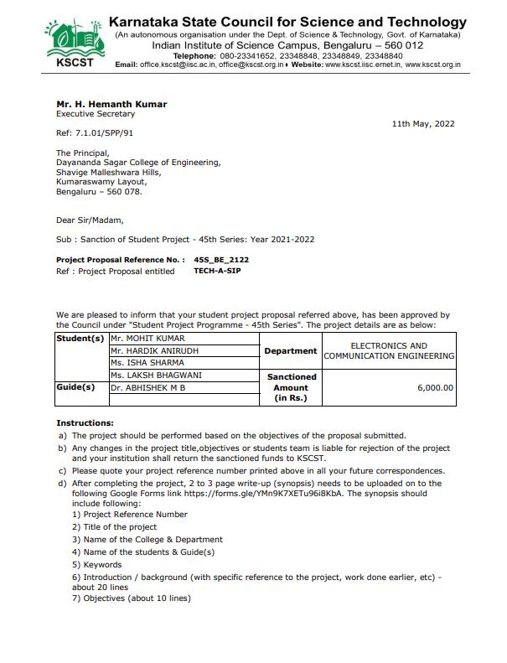
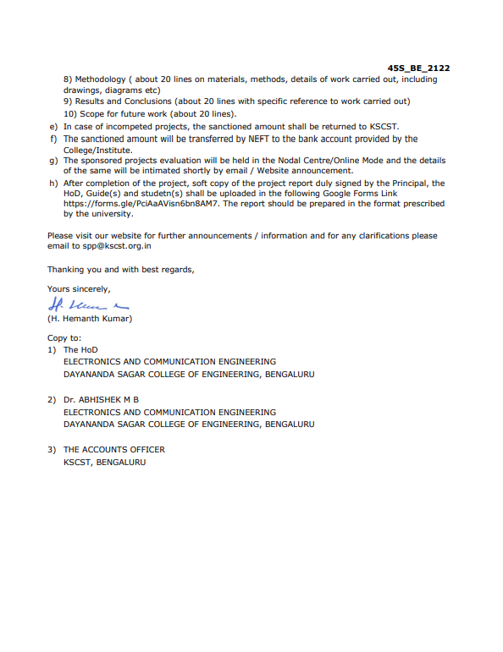
KSCST info

Slide 33
Flow of the future works (Jun’22 – July’22)
Jun-2022 | Prototyping and further optimizing for maximum efficiency
Jul-2022 | Project submission and paper presentation

Slide 34
References used
Pedro Martinez-Santos ,” Does 91% of the world’s population really have “sustainable access to safe drinking water?”,03 March, 2017, International Journal of Water Resources Development,volume:33, DOI:10.1080/07900627.2017.1298517.
A. Grandjean (WHO): “Water Requirements, Impinging Factors, and Recommended Intakes”,Jan 2009.
P.B. Pankajavalli, R. Saikumar, R.Maheswaran, "Hydration reminding samrt bottle: IoT experimentation",India , IEEE, ISBN-978-1-5090-5682-8, Jan 04, 2018
Emil Jovanov, Vindhya R Nallathimmareddygari, Jonathan E. Pryor, “SmartStuff: A Case Study of a Smart Water Bottle”, 2016 38th Annual International Conference of the IEEE Engineering in Medicine and Biology Society(EMBC),ISSN-1558-4615, Oct 18,2016.
Nam Eui Lee, Tae Hwa Lee, Dong Heui Seo, Sung Yeon Kim, “A Smart Water Bottle for New Seniors: Internet of Things (IoT) and Health Care Services”, August 2015, International Journal of Bio-Science and Bio-Technology, Volume 7 Number 4(2015), page:305-314.
LaizhongCui· ShuYang· FeiChen · ZhongMing· NanLu· JingQin, “A survey on application of machine learning for Internet of Things”, International Journal of Machine learning and Cybernetics 9, 1399-1417 (2018), June 11, 2018.
Yogendra Singh Parihar, “Internet of Things and Nodemcu: A review of use of Nodemcu ESP8266 in IoT products”,National Informatics Centre,U.P.(India),ISSN-2349-5162, Volume 6, Issue 6 June 2019.
Bo Dong, Ryan Gallant and Subir Biswas , “A self monitoring water bottle for tracking liquid intake”, Washington USA, IEEE, ISBN-978-1-4673-6364-8, Feb 12, 2015.
Ben-Chioma, A.E, Jack, A.S, Philipokere, “A Comparative study on the measurement of pH of water, using pH meter and water testing kit (testube method) in port Harcourt”, Aug 2015.
Hanan,Anak Agung Ngurah Gunawan, Made Sumadiyas, "Water level detection system based on ultrasonic sensors HC-SR04 and ESP8266-12 Modules with telegram and buzzer communication media", Instrumentation Mesure Métrologie, pages: 305-309, Aug 30,2019.
Paola Pierleoni, Roberto Concetti, Alberto Belli, Lorenzo Palma, "Amazon, Google and Microsoft Solutions for IoT: Architectures and Performance Comaparsion", IEEE, ISSN-2169-3536, Volume:8, Pages: 5455-5470, Dec 23,2019.
Choopan Rattanapoka, Somphop Chanthakit, Apatsaraporn Chimchai,Amorntip Sookkeaw,"An MQTT-based IoT Cloud platform with flow design by node-red", Bangkok, IEEE, ISBN-978-1-7281-4100-8, Feb 17, 2020.

Slide 35
THANK YOU

